Slide 1
01 | Introduction to Bootstrap
Christopher Harrison, Content Developer, Microsoft

Slide 2
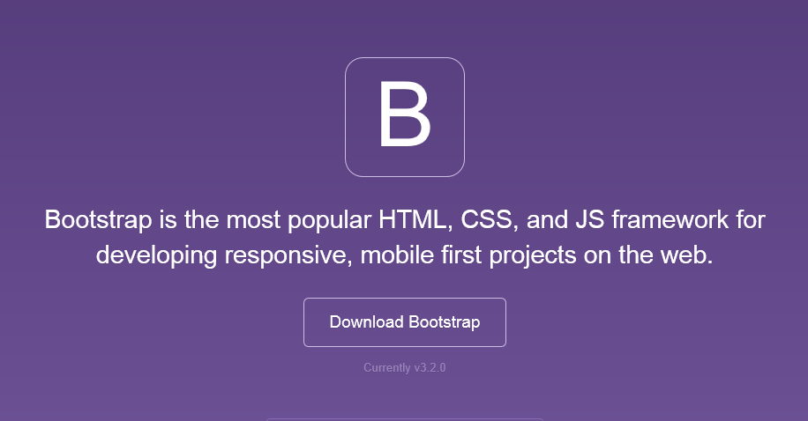
Bootstrap
The most popular front-end framework for developing responsive, mobile first projects on the web.

Slide 3
Why use it?
CSS is can be tricky
Cross browser support can be a challenge
Solves basic tasks (e.g. page layout without tables)
Bootstrap 3 makes it easier

Slide 4
Bootstrap Features
Theme Support
Responsive
Grid
Components
Pagination
Buttons
Modal
Great Visual Studio support

Slide 5





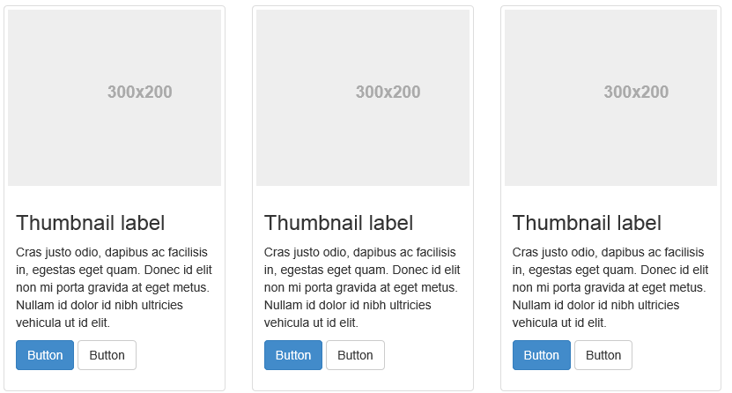
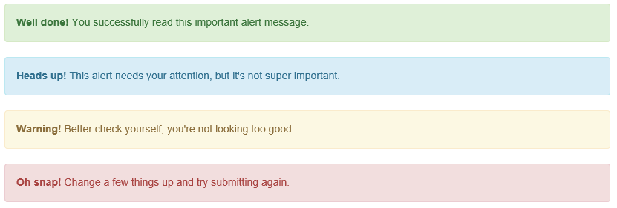
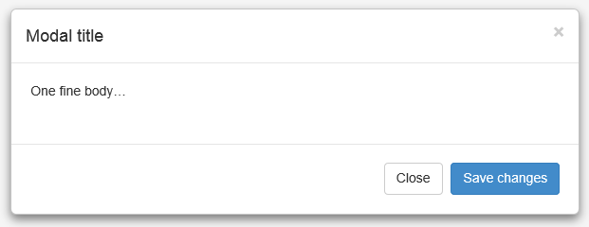
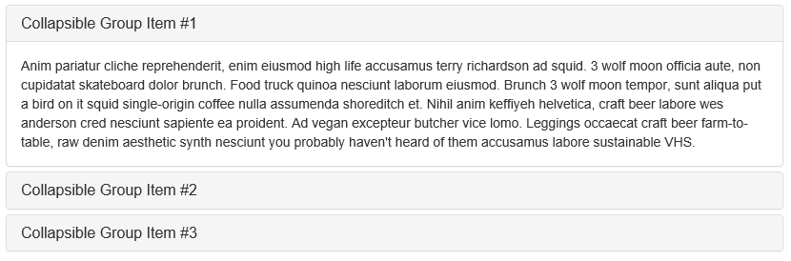
Components

Slide 6
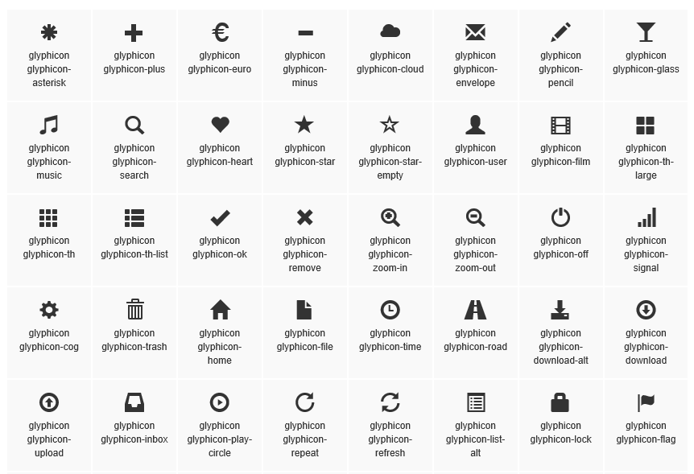
Glyphicons

Slide 7
A quick lap around Bootstrap

Slide 8
Theme Support

Slide 9
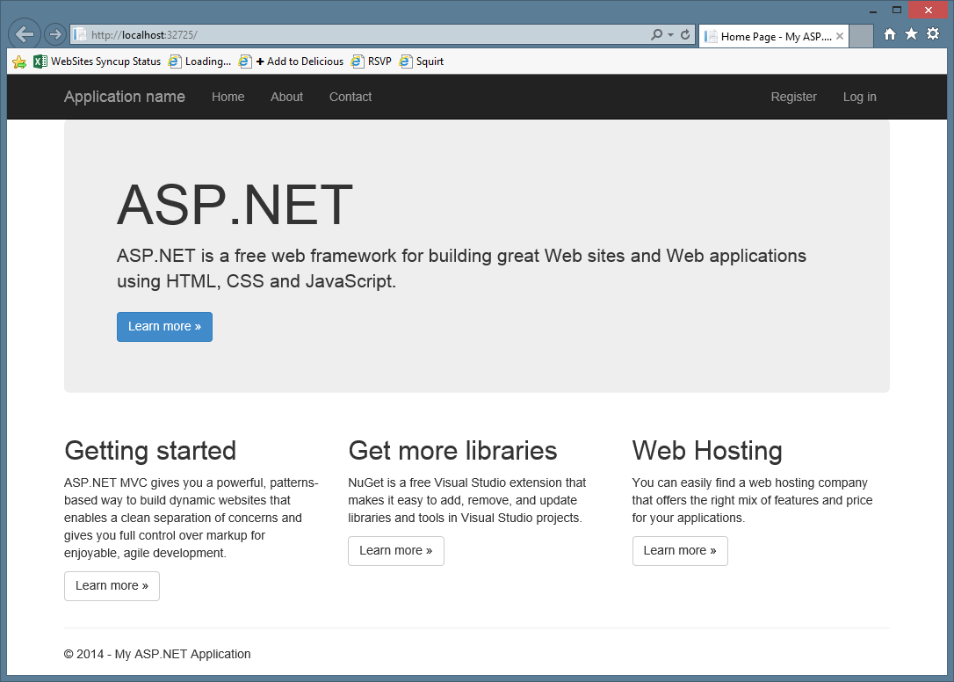

Slide 10
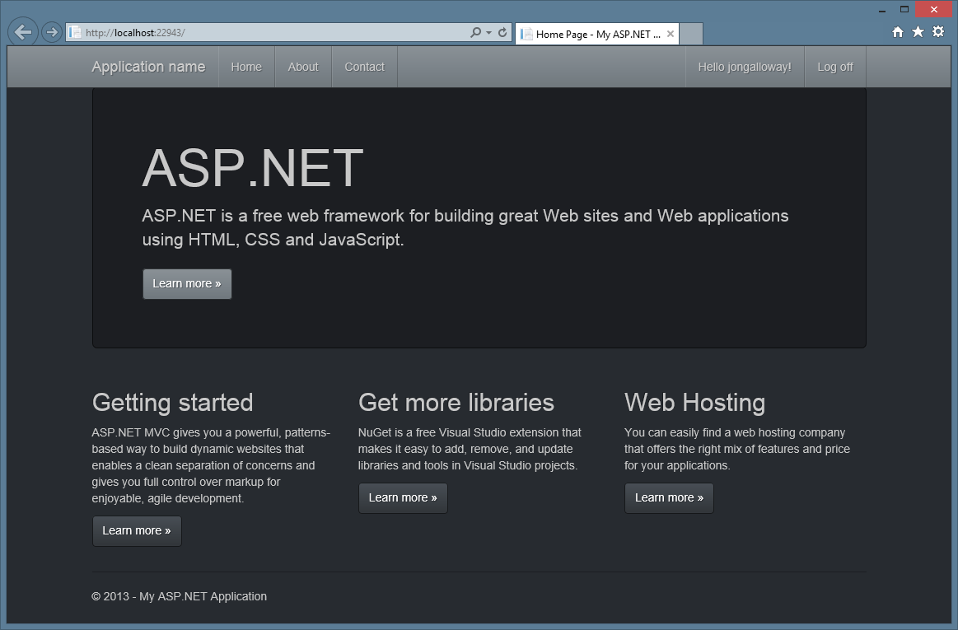

Slide 11
Bootstrap themes

Slide 12
Responsive Layout
Notes:
Bootswatch

Slide 13
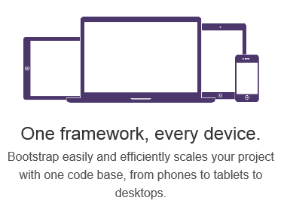
Responsive Layout

Slide 14
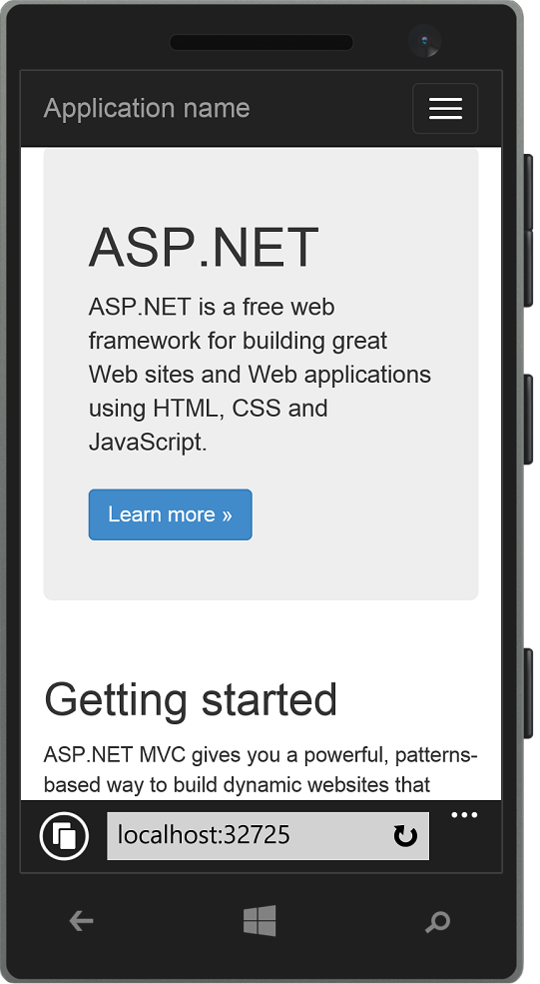
Responsive Layout

Slide 15
Bootstrap - Responsive
Notes:
Show page responding to screen width changes
Show page in mobile browser
Emphasize that this is just HTML and CSS – no server or JS code

Slide 16
Grid System

Slide 17
Grid system
 | Extra small devices Phones (<768px) | Small devices Tablets (≥768px) | Medium devices Desktops (≥992px) | Large devices Desktops (≥1200px)
Grid behavior | Horizontal at all times | Collapsed to start, horizontal above breakpoints
Container width | None (auto) | 750px | 970px | 1170px
Class prefix | .col-xs- | .col-sm- | .col-md- | .col-lg-
# of columns | 12
Column width | Auto | 60px | 78px | 95px
Gutter width | 30px (15px on each side of a column)

Slide 18
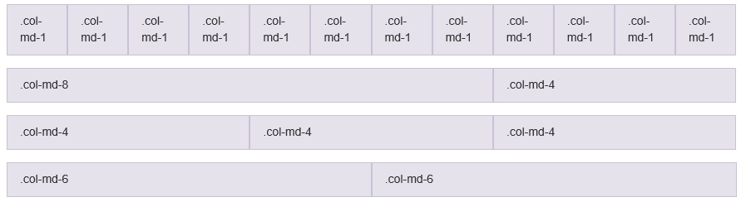
Grid system

Slide 19
Bootstrap - Grid
Notes:
Christopher - Grid

Slide 20
Visual Studio support

Slide 21
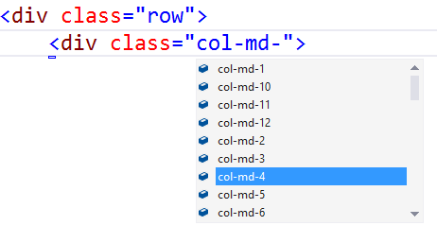
Visual Studio – Class IntelliSense

Slide 22
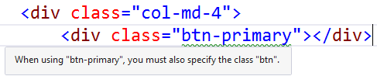
Visual Studio – Missing Class Detection

Slide 23
Bootstrap – Visual Studio Support

